Slide 1
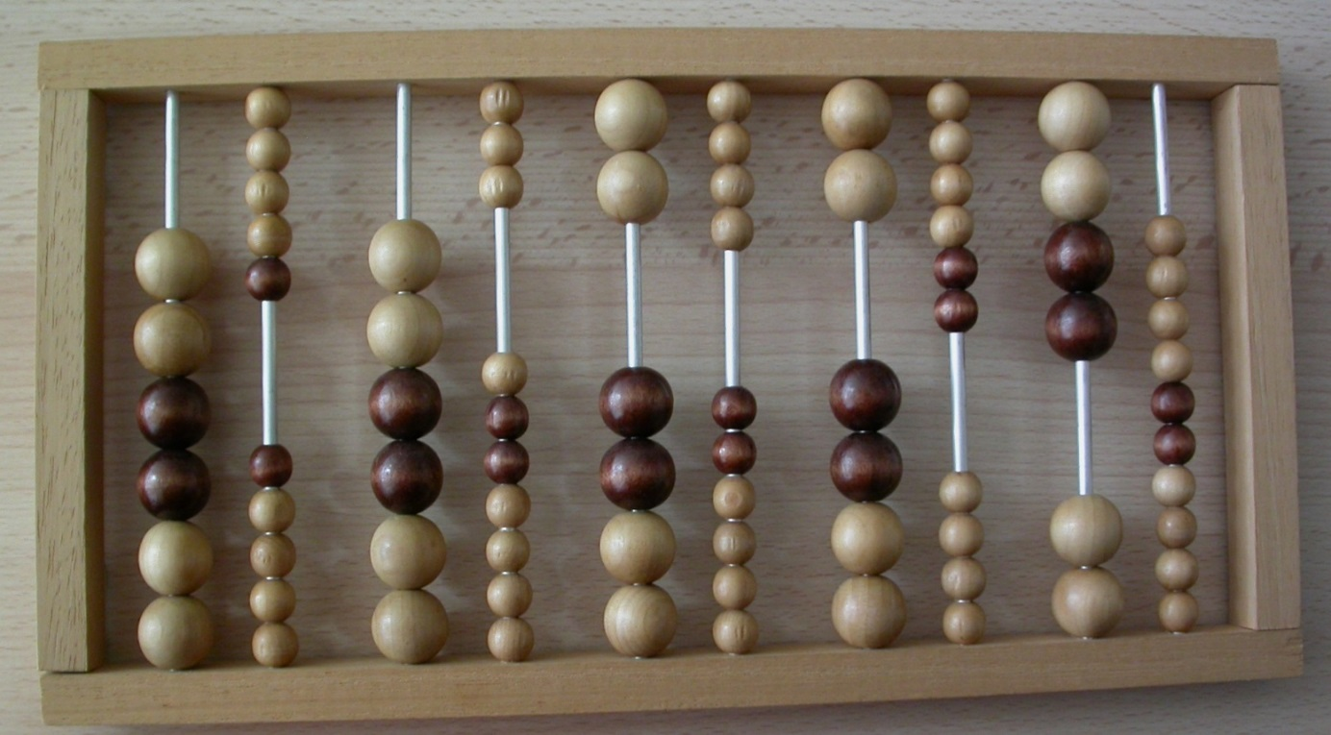
Des instruments aux ressources
Trajectoires parallèles et perspectives croisées
Christine Proust
(SPHERE,
CNRS & Université de Paris)
Des instruments aux ressources vivantes en mathématiques,
autour du travail de Luc Trouche
Mercredi 26 juin 2019 ENS de Lyon

Slide 2
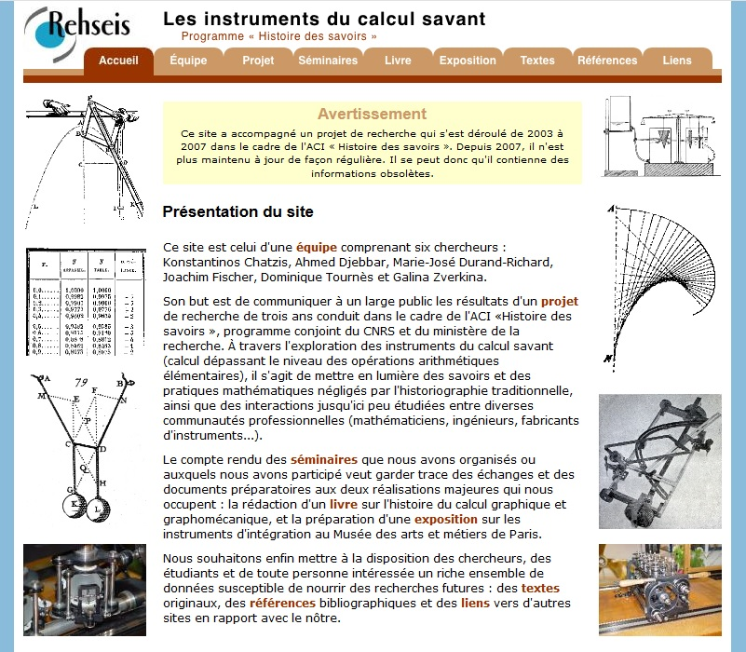

Slide 3
“When history and didactics meet…”

Slide 4
Proust. 2012. "Teachers' writings and students' writings…." in From Text to 'Lived' Resources…, ed. Gueudet, Pepin, and Trouche
Trouche. 2016. "The Development of Mathematics Practices in the Mesopotamian Scribal Schools. …” in Tools and Mathematics. Instruments for learning, Mathematics Education Library, ed. Monaghan, Trouche, and Borwein
What we learn from the material of scribal schools, more than 1000 years after the invention of writing, is that writing did not replace, in schools, memorisation and that tablets did not replace tokens: on the contrary the combination of different means supporting calculations seems to have led to a constitution of a few articulated levels of mathematics practices: manipulating numbers through tokens, memorising tables and intermediate results, developing and using highly structured algorithms dedicated to specific mathematical tasks, expressed in a very few lines for saving place on clay tablets.
…
The flexibility of computing, that is the ability of switching between several frames, semiotic registers (Mariotti and Maracci, 2012) or points of view (see Chap. 8), in the case of scribal schools the switching between the writing on clay tablets and the manipulation of tokens via wooden device; or the switching between computations on numbers, and computations on quantities; or the switching between a wedges-based representation and a token-based representation.
The resources of the masters [. . .] might have included a complex system of written texts, memorised texts, calculation devices and various communicational processes, but only the written artefacts reached us. We have then to reconstruct a rich environment from truncated evidence.

Slide 5
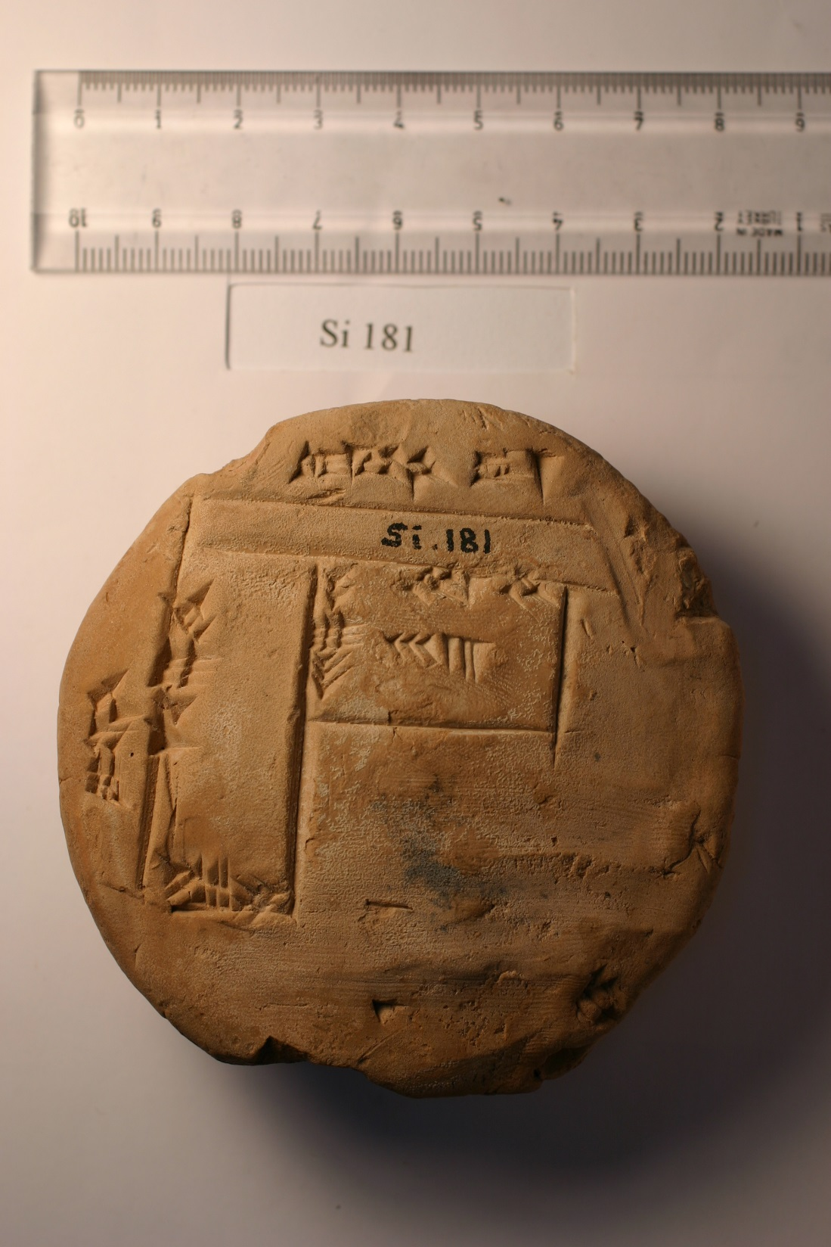
Balanced account, Southern Mesopotamia, end of the third millenium BCE (ca. 2042 BCE)
School tablet, Central Mesopotamia, second millenium BCE (ca. 1700 BCE)

Slide 6
Xiaoli Ouyang and Christine Proust. forthcoming. "Place value notations in the Ur III period: marginal numbers in administrative texts." in Cultures of computation and quantification, Why the Sciences of the Ancient World Matter, edited by K. Chemla, A. Keller, and C. Proust. Springer, series “Why the Sciences of the Ancient World Matter”.
Xiaoli Ouyang and Christine Proust. 2015. "Lianghe liuyu liushi jinzhi weizhizhi jishufa zaoqi fazhan de xin zhengju ji qi fenxi 两河流域六十进制位值记数法早期发展的新证据及其分析(New evidence of the early development of the Mesopotamian sexagesimal place value number system and its analysis)." Ziran kexueshi yanjiu 自然科学史研究 (Research in the history of natural sciences) 34:201-221.

Slide 7
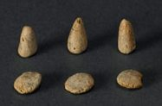


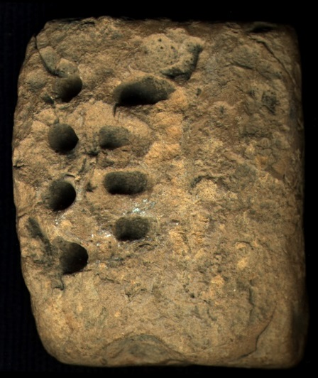
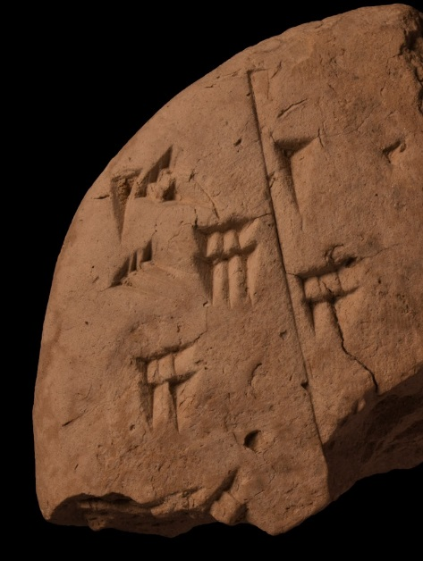
From objects to texts
Token
(from VIIIth millennium BCE)
Pre-cuneiform texts
(ca. 4500-4000 BCE)
Cuneiform texts
(ca. 3500-0 BCE)

Slide 8


From texts to objects
(CBS 1215 #20)
Token?
Abacus?
Model by Baptiste Mélès

Slide 9
A balance account for
silver values of lard and copper
Provenance: Umma, Date: ca. 2042
Pouchkine Museum, Moscou (nO public; Nik 2, 402)
Total expenses in silver: 12 5/6 gin 23 1/2 še
Amount of silver advanced by the governor of Umma to the supplier.
Detail of the goods bought with this amount of silver by the supplier on behalf of the governor:
about 96 liters of lard,
value 5 ½ gin 23 ½ še
About 5.5 kg of copper,
value 7 1/3 gin
12:50
23:30
1 gin ≈ 8g; 1 še ≈ 4 cg.

Slide 10
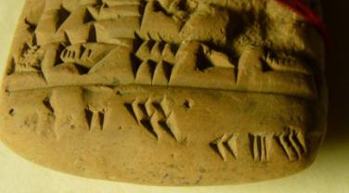
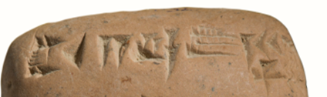
in total: 12 5/6 gin 23 1/2 še
12:50
23:30
×180
×60
×3
gin | še
12 5/6 | 23 1/2
gin |  | še
12 | 50 | 23 | 30

Slide 11
Possible process of calculation (addition) in Nik 2, 402
Main text
(measurement values)
Margins
(place value notation, partially sexa.)
Instrument
(mind, abacus or tokens)
5 ½ gin 23 ½ še
7 1/3 gin
5 30 // 23:30
7:20
Transformation
Transfert
Input
Addition
12 5/6 gin 23 ½ še
Transformation
12:50 // 23:30
Transfert
Output

Slide 12
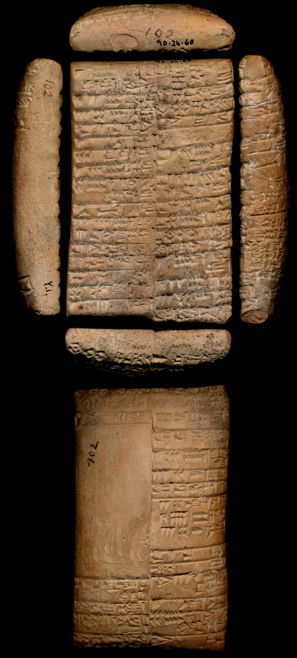
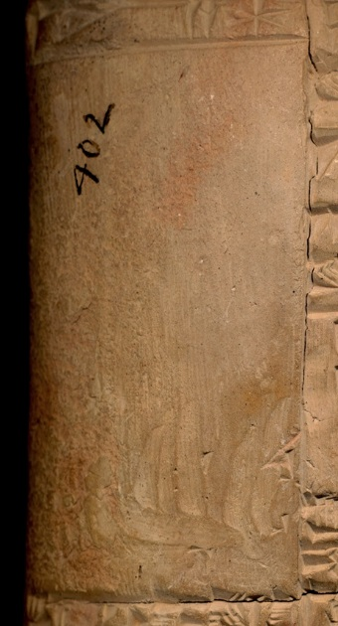
A new project: the philology of blank spaces
Photo CDLI
IMJ 90.024.0060 (Atiqot 4, pl. 4 n°7) Ur III, Girsu

Slide 13
Pluralité des concepts liés aux unités de mesure
Liens entre histoire des sciences et didactique,
le cas de l’aire du carré dans une sélection de textes anciens
Par Charlotte de Varent
Thèse de doctorat de Didactique et d’Histoire des mathématiques
Considering the didactical material with historical perspective and questions
Considering the historical material with didactical perspective and questions

Slide 14
